Slide 1
COMS 4111: Introduction to Databases Lecture 14: Midterm Discussion, Database Systems Implementation (I): Disks
Dr. Donald F. Ferguson
dff9@columbia.edu

Slide 2
Midterm

Slide 3
General Observations

Slide 4
This Pretty Much Sums it Up.
“Good luck grading Dude.”

Slide 5
“I Have a Cunning Plan.”
I very carefully designed the exam.
I designed each question
To test knowledge of a specific set of concepts.
And some lay the foundation for future course topics, e.g.
Transactions
Graph Databases
Document databases
DB applications
All I can say is,
“Epic, Epic fail.”

Slide 6
Resolution
I apologize. You deserve better.
I am going to personally review and grade all midterms.
I cannot burden the CAs with extracting
Reasonable grades from
An unreasonable test.
Goal is to be complete by next week.
My focus will be to determine how well you learned the concepts
Based on what you were able to complete
And NOT how much you much you completed.
My target is approximately 10% B+, 40% A-, 30%, 20% A+.
Regarding the final exam, …

Slide 7
Let’s Not Do That Again.
Final will take a completely different approach.

Slide 8
Midterm Answers
Problem 1 was relatively straightforward, and I posted my solution.
I will cover problem 5 in this lecture. Brings together key concepts in one problem
We need to start moving onto the next topics in the course. I do not want to use lectures to answer the other questions. So,
I will produce DDL.
A presentation explaining solution.
Record the presentation
For the other 3 problems and extra-credit.

Slide 9
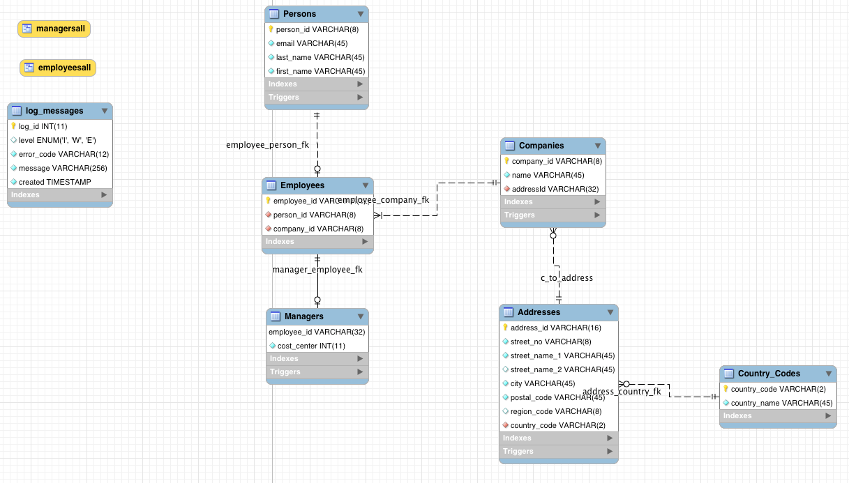
Question 5 – (I) Person Datamodel
What I was looking for …

Slide 10
Question 5 – Person
CREATE TABLE `Persons` ( `person_id` varchar(8) NOT NULL, `email` varchar(45) NOT NULL,a `last_name` varchar(45) NOT NULL, `first_name` varchar(45) NOT NULL, PRIMARY KEY (`person_id`), UNIQUE KEY `email_UNIQUE` (`email`) ) ENGINE=InnoDB DEFAULT CHARSET=utf8; CREATE TABLE `Employees` ( `employee_id` varchar(32) NOT NULL, `person_id` varchar(8) NOT NULL, `company_id` varchar(8) NOT NULL, PRIMARY KEY (`employee_id`), UNIQUE KEY `person_id_UNIQUE` (`person_id`), KEY `employee_person_fk_idx` (`person_id`), KEY `employee_company_fk_idx` (`company_id`), CONSTRAINT `employee_company_fk` FOREIGN KEY (`company_id`) REFERENCES `Companies` (`company_id`) ON DELETE NO ACTION ON UPDATE NO ACTION, CONSTRAINT `employee_person_fk` FOREIGN KEY (`person_id`) REFERENCES `Persons` (`person_id`) ON DELETE NO ACTION ON UPDATE NO ACTION ) ENGINE=InnoDB DEFAULT CHARSET=utf8; CREATE TABLE `Managers` ( `employee_id` varchar(32) NOT NULL, `cost_center` int(11) NOT NULL, PRIMARY KEY (`employee_id`), CONSTRAINT `manager_employee_fk` FOREIGN KEY (`employee_id`) REFERENCES `Employees` (`employee_id`) ON DELETE NO ACTION ON UPDATE NO ACTION ) ENGINE=InnoDB DEFAULT CHARSET=utf8;
I did a 3 table solution.
A 1 or 2 table solution would be OK. A lot of people/real solutions would actually merge employee and manager into one table.

Slide 11
Question 5 – Person
CREATE DEFINER=`root`@`localhost` FUNCTION `can_add_manager`(company_id VARCHAR(8)) RETURNS tinyint(1) BEGIN DECLARE e_count INT; DECLARE is_ok BOOLEAN; SET e_count = (SELECT COUNT(*) FROM Employees WHERE Employees.company_id = company_id); IF (e_count < 2) THEN SET is_ok = FALSE; ELSE SET is_ok = TRUE; END IF; RETURN is_ok; END

Slide 12
Question 5 – Person
CREATE DEFINER=`root`@`localhost` TRIGGER `midterm-orders`.`Managers_BEFORE_INSERT` BEFORE INSERT ON `Managers` FOR EACH ROW BEGIN DECLARE is_ok BOOLEAN; DECLARE c_id VARCHAR(8); SET c_id = (SELECT Employees.company_id FROM Employees WHERE Employees.employee_id=New.employee_id); SET is_ok = can_add_manager(c_id); IF is_ok = FALSE THEN CALL handle_error("05002", "Not enough employees to INSERT a manager."); END IF; END

Slide 13
Question 5 – Person
CREATE DEFINER=`root`@`localhost` PROCEDURE `create_employee`(company_id VARCHAR(8), email VARCHAR(32), last_name VARCHAR(32), first_name VARCHAR(32), is_manager BOOLEAN, cost_center INT) BEGIN DECLARE p_id VARCHAR(8); DECLARE e_id VARCHAR(32); DECLARE c_id VARCHAR(8); DECLARE e_count INT; DECLARE is_ok BOOLEAN; SET is_ok = TRUE; -- Generate a globally unique person_id based on last_name. SET p_id = create_person_id(last_name); -- Sort of a check to make sure the company actually exists. SET c_id = (SELECT company_id FROM Companies WHERE Companies.company_id = company_id); if (c_id IS NULL) THEN CALL handle_error('05003', 'Company does not exists for the employee.'); END IF; -- Form an employee ID from the compani_id and person_id. SET e_id = CONCAT(c_id, '-', p_id);

Slide 14
Question 5 – Person
-- Is this a request to create a manager? IF (is_manager) THEN -- Validate that adding a manager is possible. SET is_ok = can_add_manager(company_id); -- If adding is not possible, then explode. IF (is_ok = FALSE) THEN SIGNAL SQLSTATE '05001' SET MESSAGE_TEXT='Not enough employees for a manager.'; END IF; END IF; -- Adding is allowed. IF (is_ok) THEN -- We make a Person then make an Employee. INSERT INTO Persons (person_id, email, last_name, first_name) VALUES(p_id, email, last_name, first_name); INSERT INTO Employees (employee_id, person_id, company_id) VALUES(e_id, p_id, company_id); -- If requested, create a manager. IF (is_manager) THEN INSERT INTO Managers VALUES(e_id, cost_center); END IF; END IF; END

Slide 15
Some Views
CREATE ALGORITHM = UNDEFINED DEFINER = `root`@`localhost` SQL SECURITY DEFINER VIEW `midterm-orders`.`employeesall` AS SELECT `midterm-orders`.`persons`.`person_id` AS `person_id`, `midterm-orders`.`persons`.`email` AS `email`, `midterm-orders`.`persons`.`last_name` AS `last_name`, `midterm-orders`.`persons`.`first_name` AS `first_name`, `midterm-orders`.`employees`.`employee_id` AS `employee_id`, `midterm-orders`.`employees`.`company_id` AS `company_id` FROM (`midterm-orders`.`persons` JOIN `midterm-orders`.`employees` ON ((`midterm-orders`.`employees`.`person_id` = `midterm-orders`.`persons`.`person_id`)))

Slide 16
Some Views
CREATE ALGORITHM = UNDEFINED DEFINER = `root`@`localhost` SQL SECURITY DEFINER VIEW `midterm-orders`.`managersall` AS SELECT `employeesall`.`person_id` AS `person_id`, `employeesall`.`email` AS `email`, `employeesall`.`last_name` AS `last_name`, `employeesall`.`first_name` AS `first_name`, `employeesall`.`employee_id` AS `employee_id`, `employeesall`.`company_id` AS `company_id`, `midterm-orders`.`managers`.`cost_center` AS `cost_center` FROM (`midterm-orders`.`employeesall` JOIN `midterm-orders`.`managers` ON ((`midterm-orders`.`managers`.`employee_id` = `employeesall`.`employee_id`)))

Slide 17
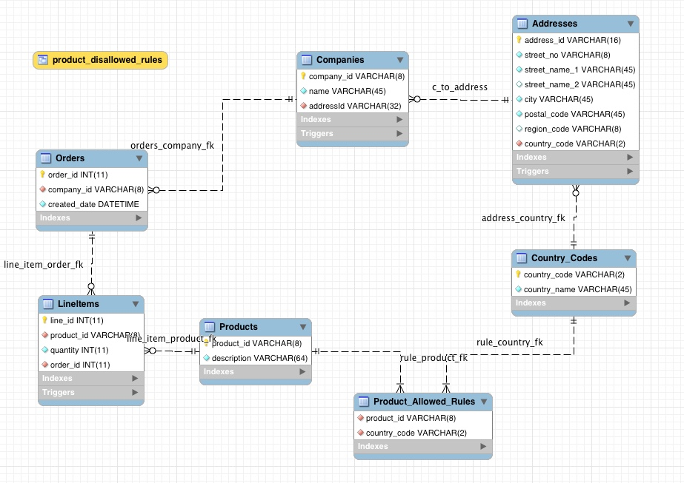
Question 5 – (II) Order Management Datamodel
What I was looking for …

Slide 18
Question 5 – Order Management
CREATE TABLE `Addresses` ( `address_id` varchar(16) NOT NULL, `street_no` varchar(8) NOT NULL, `street_name_1` varchar(45) NOT NULL, `street_name_2` varchar(45) DEFAULT NULL, `city` varchar(45) NOT NULL, `postal_code` varchar(45) NOT NULL, `region_code` varchar(8) DEFAULT NULL, `country_code` varchar(2) NOT NULL, PRIMARY KEY (`address_id`), UNIQUE KEY `unique_index` (`street_no`,`street_name_1`,`street_name_2`,`city`,`postal_code`,`country_code`,`region_code`), KEY `address_country_fk_idx` (`country_code`), KEY `postal_code_idx` (`postal_code`), CONSTRAINT `address_country_fk` FOREIGN KEY (`country_code`) REFERENCES `Country_Codes` (`country_code`) ON DELETE NO ACTION ON UPDATE NO ACTION ) ENGINE=InnoDB DEFAULT CHARSET=utf8 CREATE TABLE `Country_Codes` ( `country_code` varchar(2) NOT NULL, `country_name` varchar(45) NOT NULL, PRIMARY KEY (`country_code`) ) ENGINE=InnoDB DEFAULT CHARSET=utf8

Slide 19
Question 5 – Order Management
Factoring out country_name into country_code table was optional
But typically how this would work because it keeps data consistent by preventing people from entering different values for same fact.
“UK”
“Great Britain”
“England”
… …
CREATE TABLE `Addresses` ( `address_id` varchar(16) NOT NULL, `street_no` varchar(8) NOT NULL, `street_name_1` varchar(45) NOT NULL, `street_name_2` varchar(45) DEFAULT NULL, `city` varchar(45) NOT NULL, `postal_code` varchar(45) NOT NULL, `region_code` varchar(8) DEFAULT NULL, `country_code` varchar(2) NOT NULL, PRIMARY KEY (`address_id`), UNIQUE KEY `unique_index` (`street_no`,`street_name_1`,`street_name_2`,`city`,`postal_code`,`country_code`,`region_code`), KEY `address_country_fk_idx` (`country_code`), KEY `postal_code_idx` (`postal_code`), CONSTRAINT `address_country_fk` FOREIGN KEY (`country_code`) REFERENCES `Country_Codes` (`country_code`) ON DELETE NO ACTION ON UPDATE NO ACTION ) ENGINE=InnoDB DEFAULT CHARSET=utf8 CREATE TABLE `Country_Codes` ( `country_code` varchar(2) NOT NULL, `country_name` varchar(45) NOT NULL, PRIMARY KEY (`country_code`) ) ENGINE=InnoDB DEFAULT CHARSET=utf8

Slide 20
Product – Country Constraint
“An administrator or similar role must have the ability to define a set of constraints (rules) specifying which products can be purchased in which countries.
The schema, constraints and triggers should prevent adding a line item to an Order if the purchasing customer is in a country where the product is disallowed.”
What does a rule look like?
CanPurchase(country_code, product_id) = TRUE or FALSE.

Slide 21
Implementing the Rules
CREATE TABLE `Product_Allowed_Rules` ( `product_id` varchar(8) NOT NULL, `country_code` varchar(2) NOT NULL, UNIQUE KEY `unique_entry` (`product_id`,`country_code`), KEY `rule_country_fk_idx` (`country_code`), CONSTRAINT `rule_country_fk` FOREIGN KEY (`country_code`) REFERENCES `Country_Codes` (`country_code`) ON DELETE NO ACTION ON UPDATE NO ACTION, CONSTRAINT `rule_product_fk` FOREIGN KEY (`product_id`) REFERENCES `Products` (`product_id`) ON DELETE NO ACTION ON UPDATE NO ACTION ) ENGINE=InnoDB DEFAULT CHARSET=utf8
CREATE DEFINER=`root`@`localhost` FUNCTION `product_allowed`(c_code CHAR(2), p_id VARCHAR(8)) RETURNS tinyint(1) BEGIN DECLARE answer BOOLEAN; SET answer = EXISTS (SELECT * FROM Product_Allowed_Rules WHERE product_id=p_id AND country_code=c_code); RETURN answer; END

Slide 22
Implementing the Rules
CREATE TABLE `Country_Codes` ( `country_code` varchar(2) NOT NULL, `country_name` varchar(45) NOT NULL, PRIMARY KEY (`country_code`) ) ENGINE=InnoDB DEFAULT CHARSET=utf8
CREATE DEFINER=`root`@`localhost` FUNCTION `product_allowed`(c_code CHAR(2), p_id VARCHAR(8)) RETURNS tinyint(1) BEGIN DECLARE answer BOOLEAN; SET answer = EXISTS (SELECT * FROM Product_Allowed_Rules WHERE product_id=p_id AND country_code=c_code); RETURN answer; END
How does an “administrator” or some change the rules?
INSERT, DELETE, UPDATE on the rules table.

Slide 23
Enforcing Rules
“The schema, constraints and triggers should prevent adding a line item to an Order if the purchasing customer is in a country where the product is disallowed.”
CREATE DEFINER=`root`@`localhost` TRIGGER `midterm-orders`.`LineItems BEFORE_INSERT` BEFORE INSERT ON `LineItems` FOR EACH ROW BEGIN DECLARE is_ok BOOLEAN; DECLARE order_cc CHAR(2); -- We need to know the country for the order that contains the line_item. SET order_cc = get_country_code_for_order(New.order_id); -- Is this OK? SET is_ok = product_allowed(order_cc, New.product_id); -- I got bored calling handle_error if (is_ok = FALSE) THEN SIGNAL SQLSTATE '05006' SET message_text="You are violating the law!"; END IF; END
May seem tricky, or a nightmare of a JOIN but it is not.

Slide 24
Complex Navigation for Single Value
CREATE DEFINER=`root`@`localhost` FUNCTION `get_country_for_order`(o_id INT) RETURNS varchar(32) CHARSET utf8 BEGIN DECLARE answer VARCHAR(32); DECLARE c_id VARCHAR(8); DECLARE a_id VARCHAR(8); DECLARE c_code CHAR(2); SET c_id = (SELECT company_id FROM Orders WHERE Orders.order_id=o_id); SET a_id = (SELECT addressid FROM Companies WHERE Companies.company_id=c_id); SET c_code = (SELECT country_code FROM Addresses WHERE Addresses.idAddresses=a_id); SET answer=c_code; RETURN answer; END

Slide 25
Database Management System Implementation

Slide 26
Reminder

Slide 27
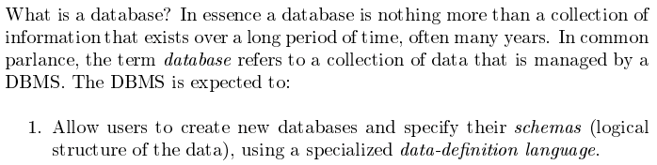
Database Management System (Lecture 1)
Covered for the relational model.
Database Systems: The Complete Book (2nd Edition) by Hector Garcia-Molina (Author), Jeffrey D. Ullman (Author), Jennifer Widom (Author)

Slide 28
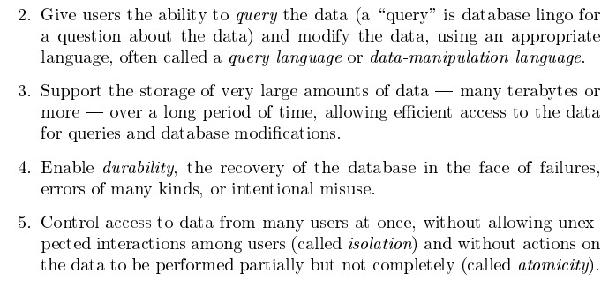
Database Management System
Focus for next part of course.
Database Systems: The Complete Book (2nd Edition) by Hector Garcia-Molina (Author), Jeffrey D. Ullman (Author), Jennifer Widom (Author)

Slide 29
Very Large Amounts of Data

Slide 30
Disks as far as the eye can see.

Slide 31
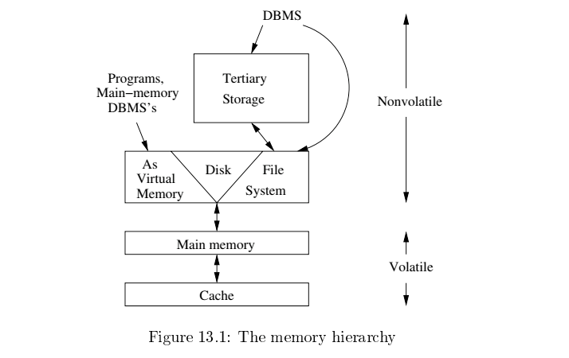
Memory Hierarchy
Slower
Cheaper
Unlimited
Faster
More expensive
Limited

Slide 32
Memory Hierarchy
Slower
Cheaper
Unlimited
Think about your laptops. Mine has
8 MB cache
16 GB RAM
516 GB disk drive
Not to mention terabytes of on backup drives, cloud, …
Same concepts apply in large scale environments, although specific technology at each tier may be different.
Faster
More expensive
Limited

Slide 33
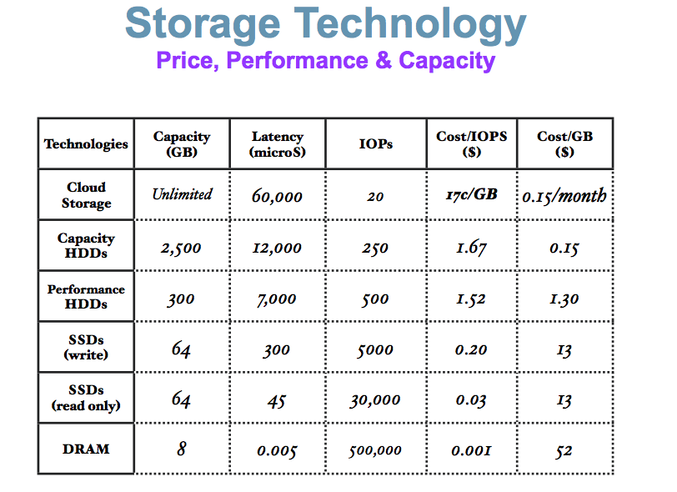
(Very Old) Comparison
These numbers are ancient.
Looking for more modern numbers.
But, does give an idea of
Price
Performance
The general observation is that
Performance goes up 10X/level.
Price goes up 10x per level.
Note: One major change is improved price performance of SDD relative to HDD for large data.

Slide 34
Another Perspective

Slide 35
Managing and Using Large Amounts of Data

Slide 36

Database Management System
Find things quickly.
Access things quickly.
Load/save things quickly.
Store things efficiently.
Database Systems: The Complete Book (2nd Edition) by Hector Garcia-Molina (Author), Jeffrey D. Ullman (Author), Jennifer Widom (Author)

Slide 37
Storage Management (I)

Slide 38
Disk Behavior and Optimization

Slide 39
Hard Disk Drive

Slide 40
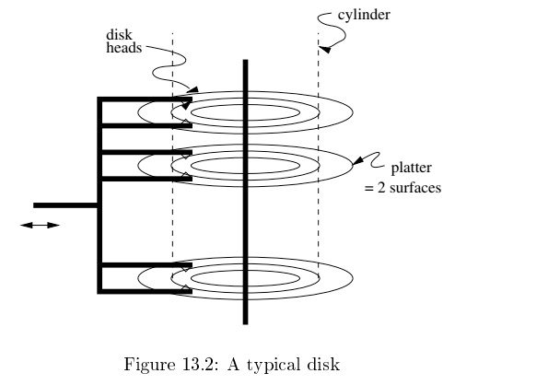
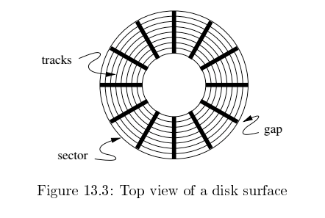
Disk Configuration
Components of disk I/O delay
Seek: Move head to cylinder/track.
Rotation: Wait for sector to get under head.
Transfer: Move data from disk to memory.
Database Systems: The Complete Book (2nd Edition) by Hector Garcia-Molina (Author), Jeffrey D. Ullman (Author), Jennifer Widom (Author)

Slide 41
Implications
I grew up in a tiny town in a very rural area.
The ”stores” were very far away and spread out.
If we were out of milk and we needed a cup of milk, we
Bought all the milk we would need for a while
AND
Anything else we needed or might need that was in the store area.
Disk I/O is the same way
Getting a block is as cheap as getting a byte.
Try to optimize your travel time by planning your trip.

Slide 42
Data Access Patterns
Think about accessing tuples in a database. The access patterns are not completely random. For example,
SELECT … ORDER BY … ➔ I look for things in sequence.
SELECT … WHERE last_name=“Smith” ➔ I look for sets of things.
CREATE VIEW AS SELECT … FROM JOIN … ON A.x=B.y ➔ I look for things in pairs of sets.
Optimizing I/O performance
Group records into blocks if accessed together.
Group blocks onto the same sector/cylinder if accessed together/sequentially ➔ Eliminates seek time.
Schedule access:
If I have to read cylinders 1, 9, 2, 8, 3
A better ordering is 1,2,3,9,8.
Stripe across disks: Read one block from 10 disks instead one 10 from 1.
Pre-fetch and preload.

Slide 43
Disk Scheduling
An example – Elevator Algorithm
Assume
The seek time from track n to m is ABS(n-m).
The I/O request queue is for sectors on tracks 1, 9, 2, 8, 3.
The head is currently on track 5.
Total seek time for FIFO processing
Seek order is 5→1→9→2→8→3
Total seek time is ABS(5-1) + ABS(1-9) + ABS(9-2) + ABS(2-8) + ABS(8-3) = 30
If the head goes all the way up and all the way down, like an elevator,
The seek order 5→8→9→3→2→1
Total seek time is ABS(5-8) + ABS(8-9) + ABS(9-3) + ABS(3-2) + ABS(2-1) = 12
There is a rich body of research and algorithms on optimizing
Blocks on tracks/sectors.
Seek/rotation optimization.

Slide 44
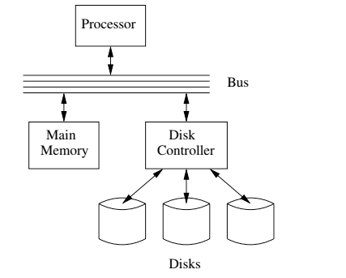
I/O Architecture
Large scale environments
The bus-controller connection is over some kind of network.
The disk controller is at the disks, and basically a “computer” with SW.
Network is either
Standard communication network, or
Highly optimized I/O network.
How we normally think of disks and I/O.

Slide 45
Disk Scheduling
Solid State Disks are becoming increasingly preferred over HDD.
Faster (no rotation or seek latency).
No moving parts → more reliable.
Even for HDDs
Disk controllers supporting DBs are very sophisticated.
A lot of the placement and scheduling optimization occurs in controller.
Seek and latency considerations are less important to the DB engine, but …
The disk is still very far away.
Some of the optimization are still important.
And, availability is still an important consideration.
An example – Elevator Algorithm
Assume
The seek time from track n to m is ABS(n-m).
The I/O request queue is for sectors on tracks 1, 9, 2, 8, 3.
The head is currently on track 5.
Total seek time for FIFO processing
Seek order is 5→1→9→2→8→3
Total seek time is ABS(5-1) + ABS(1-9) + ABS(9-2) + ABS(2-8) + ABS(8-3) = 30
If the head goes all the way up and all the way down, like an elevator,
The seek order 5→8→9→3→2→1
Total seek time is ABS(5-8) + ABS(8-9) + ABS(9-3) + ABS(3-2) + ABS(2-1) = 12
There is a rich body of research and algorithms on optimizing
Blocks on tracks/sectors.
Seek/rotation optimization.

Slide 46
Redundant Array of Independent Disks (RAID)

Slide 47
RAID (https://en.wikipedia.org/wiki/RAID)
“RAID (redundant array of independent disks) is a data storage virtualization technology that combines multiple physical disk drive components into a single logical unit for the purposes of data redundancy, performance improvement, or both. (…)
RAID 0 consists of striping, without mirroring or parity. (…)
RAID 1 consists of data mirroring, without parity or striping. (…)
RAID 2 consists of bit-level striping with dedicated Hamming-code parity. (…)
RAID 3 consists of byte-level striping with dedicated parity. (…)
RAID 4 consists of block-level striping with dedicated parity. (…)
RAID 5 consists of block-level striping with distributed parity. (…)
RAID 6 consists of block-level striping with double distributed parity. (…)
Nested RAID
RAID 0+1: creates two stripes and mirrors them. (…)
RAID 1+0: creates a striped set from a series of mirrored drives. (…)
JBOD RAID N+N: With JBOD (just a bunch of disks), (…)”

Slide 48
RAID (https://en.wikipedia.org/wiki/RAID)
Clearly, we got pretty excited and inventive defining all of these options.
My experience and some independent analysis indicates that the most common levels are
RAID-0: Striping for performance.
RAID-1: Duplication for availability.
RAID-5: Striping and parity availability.
And a lot of environments do this in software using “just a bunch of disks.”
And you still have to deal with, “Don spilled coffee of the disk array controller.”
“RAID (redundant array of independent disks) is a data storage virtualization technology that combines multiple physical disk drive components into a single logical unit for the purposes of data redundancy, performance improvement, or both. (…) ]
RAID 0 consists of striping, without mirroring or parity. (…)
RAID 1 consists of data mirroring, without parity or striping. (…)
RAID 2 consists of bit-level striping with dedicated Hamming-code parity. (…)
RAID 3 consists of byte-level striping with dedicated parity. (…)
RAID 4 consists of block-level striping with dedicated parity. (…)
RAID 5 consists of block-level striping with distributed parity. (…)
RAID 6 consists of block-level striping with double distributed parity. (…)
Nested RAID
RAID 0+1: creates two stripes and mirrors them. (…)
RAID 1+0: creates a striped set from a series of mirrored drives. (…)
JBOD RAID N+N: With JBOD (just a bunch of disks), (…)”

Slide 49
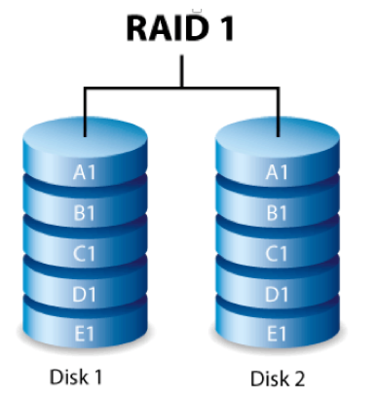
RAID-0 and RAID-1
Two physical disks make one single, logical fast disk
Two physical disks make one single, logical reliable disk
Single “Fast” Disk
Single “Reliable” Disk

Slide 50
RAID-5
One Big Logical Disk
Improved performance through parallelism
Rotation/seek
Transfer
Availability uses parity blocks
Suppose I have 4 different data blocks on the logical drive A: A1, A2, A3, A4.
Parity function: Ap = P(A1,A2,A3,A4)
Recovery function: A2=R(Ap,A1,A3,A4)
During normal operations:
Read processing simply retrieves block.
Write processing of A2 updates A2 and Ap
If an individual disk fails, the RAID
Read
Continues to function for reads on non-missing blocks.
Implements read on missing block by recalculating value.
Write
Updates block and parity block for non-missing blocks.
Computes missing block, and calculates parity based on old and new value.
Over time
“Hot Swap” the failed disk.
Rebuild the missing data from values and parity.
Is actually 5 smaller “logical” disks.
A
B
C
D
E
Logical disk data spread over 5 physical disks.

Slide 51
Very Simple Parity Example
Even-Odd Parity
b[i] is an array of bits (0 or 1)
P(b[i]) =
0 is an even number of bits = 1. {P([0,1,1,0,1,1])= 0
1 if an odd number of bits = 1. {P(0,0,1,0,1,1]= 1
Given an array with one missing bit and the parity bit, I can re-compute the missing bit.
Case 1: [0,?,1,0,1,1] has P=0. There must be an EVENnumber of ones and ?=1.
Case 2: [0,?,1,0,1,1] has P=1. There must be an ODD number of ones and ?=0.
Block Parity applies this to a set of blocks bitwise
A1=[0,1,0,0,1,1]
A2=[1,1,1,0,0,0]
A3=[0,0,0,1,0,1]
Pa=[1,0,1,1,1,0]
➔
If I am missing a block and have the parity block, I can re-compute the missing block bitwise.

Slide 52
Summary
Almost all of this complexity and functionality is hidden from
Database developers.
Database designers and administrators.
Data center, cloud and large scale infrastructure architects
Evaluate and design disk technology and architecture
In combination with other critical technology, e.g.
Networking
Process/compute nodes.
Some customer, optimized, advanced data solutions are a combination of
Custom, optimized database implementation.
Co-designed with underlying infrastructure design.

